Slide 1
RAMAN KALVI NILAYAM - THE BEGINNING OF A TRANSFORMATION
BY
VISHAKAN RAMAN

Slide 2
THE BEGINNING
Raman Kalvi Nilayam (RKN) was founded by Mrs Thavamony Raman in the year 2000.
We , at RKN, strongly believe that every individual is an achiever in his / her own way.
Thus we aim to bring out the best in the individual by providing them with quality training and adequate level of motivation.
We design the path to your dreams !!

Slide 3
OUR MOTTO
RKN was started with an important objective of educating and training the younger generation to be competent, self confident and creative individuals filled with moral values which will enable them to handle people in a better manner.

Slide 4
WHY RKN?
Because We are a pioneer in this field.
At RKN , we not only equip our students with knowledge but also with a strong mental fortitude to face the challenges of life
We have designed our courses in such a way that they get a splendid and amazing learning experience.
In short , Education at RKN is amusing, entertaining , fun and interactive.

Slide 5
WHAT’S SPECIAL ?
Our Faculty members clearly understand the needs of our students particularly those from rural schools and the modern day challenges that the students might have to face when they come to city for pursuing their higher studies.

Slide 6
OUR ACHIEVEMENTS
RKN has always shown a keen interest in the welfare of the students studying in Government schools especially those in rural parts of TamilNadu .
Over the past 14 years , we have imparted the knowledge of English Language in the best possible way, focussing mainly on the Tamil medium students by alleviating their fear of talking in English and making them fluent in the language.

Slide 7
OUR ACHIEVEMENTS
Our founder , Mrs.Thavamony Raman has been interviewed for her achievements by the press and print media including “The Hindu” , “The New India Express” and DD Podhigai.
The achievements include giving training to corporation school girls, school dropouts and teachers and helping them master the language.

Slide 8
THE HINDU ARTICLE DATED 08-JUNE 2002 – (1)

Slide 9
THE HINDU ARTICLE DATED 08-JUNE 2002 – (2)

Slide 10
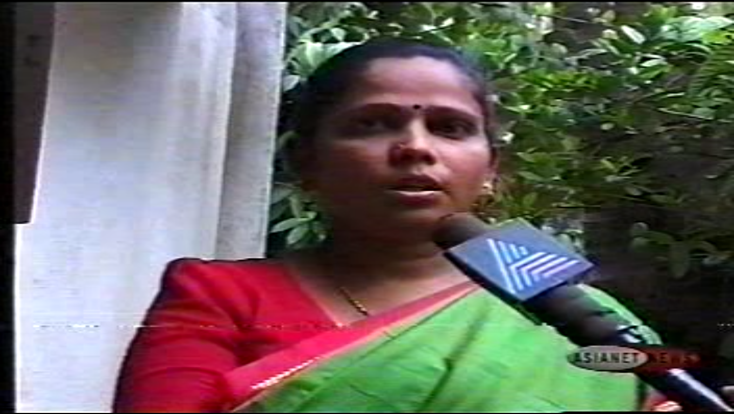
ASIANET NEWS COVERAGE

Slide 11
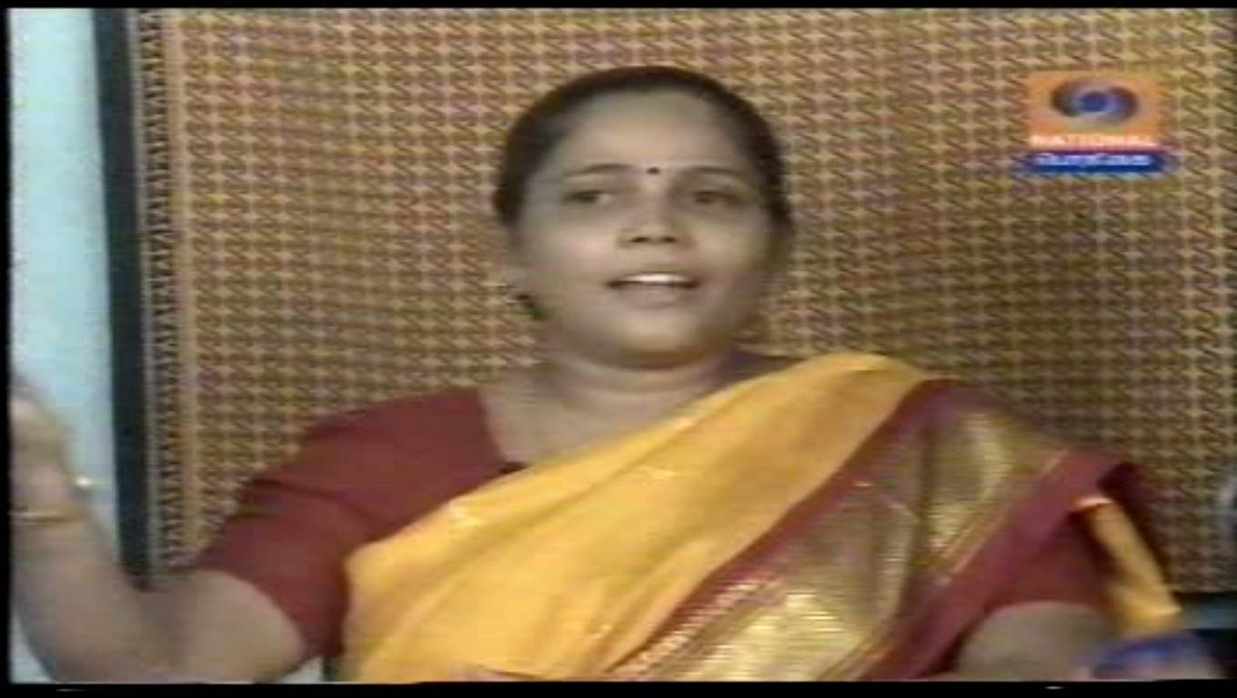
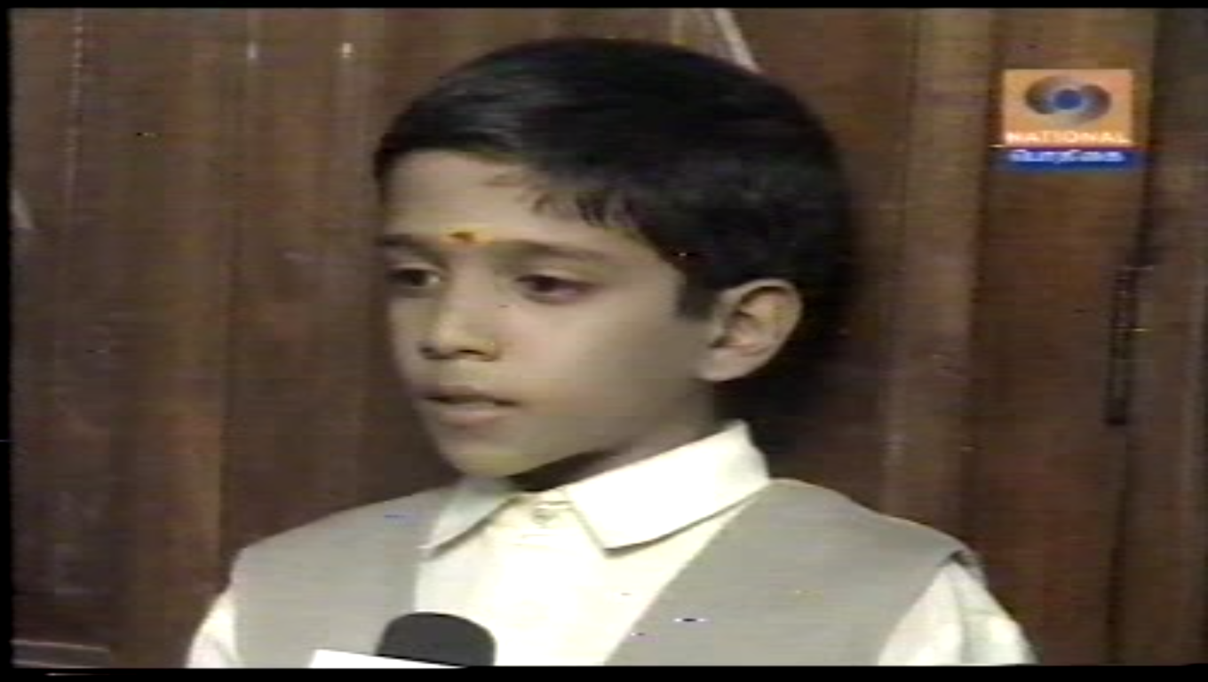
DD PROGRAM COVERAGE (1)

Slide 12
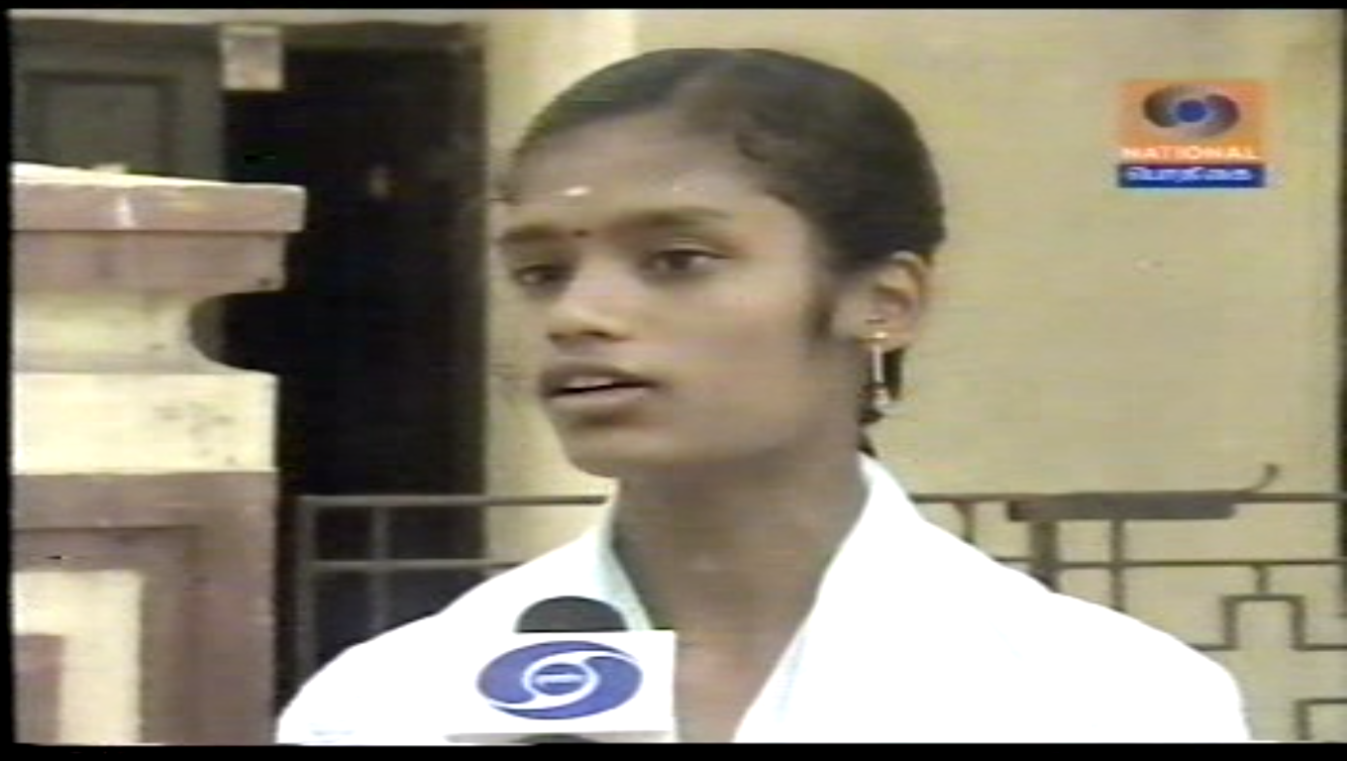
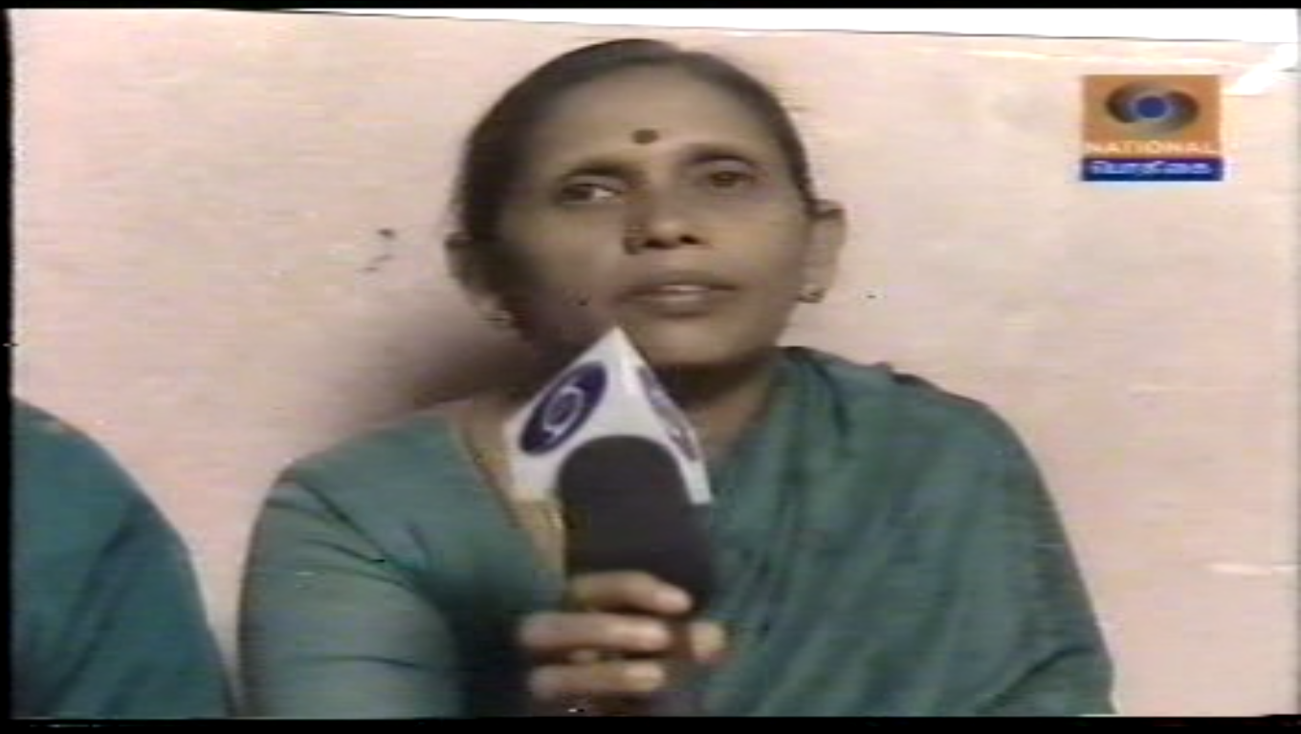
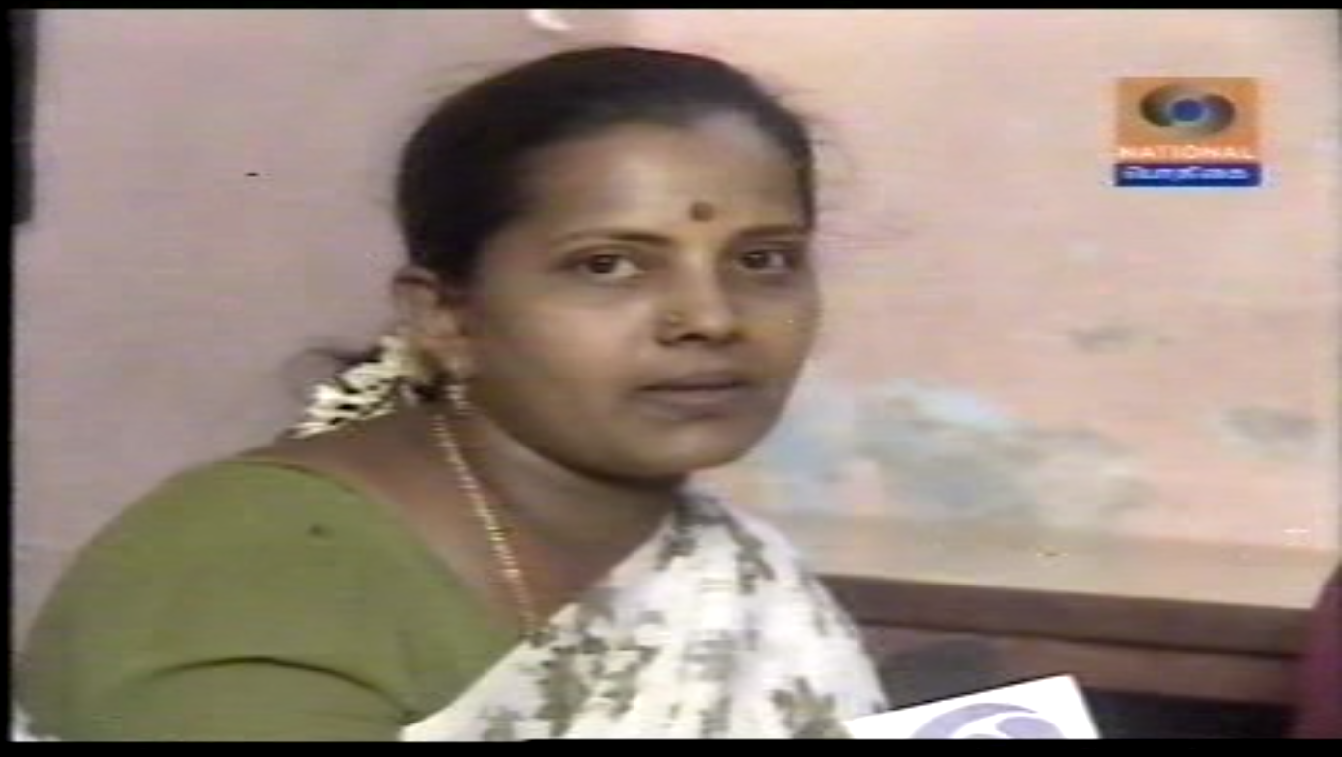
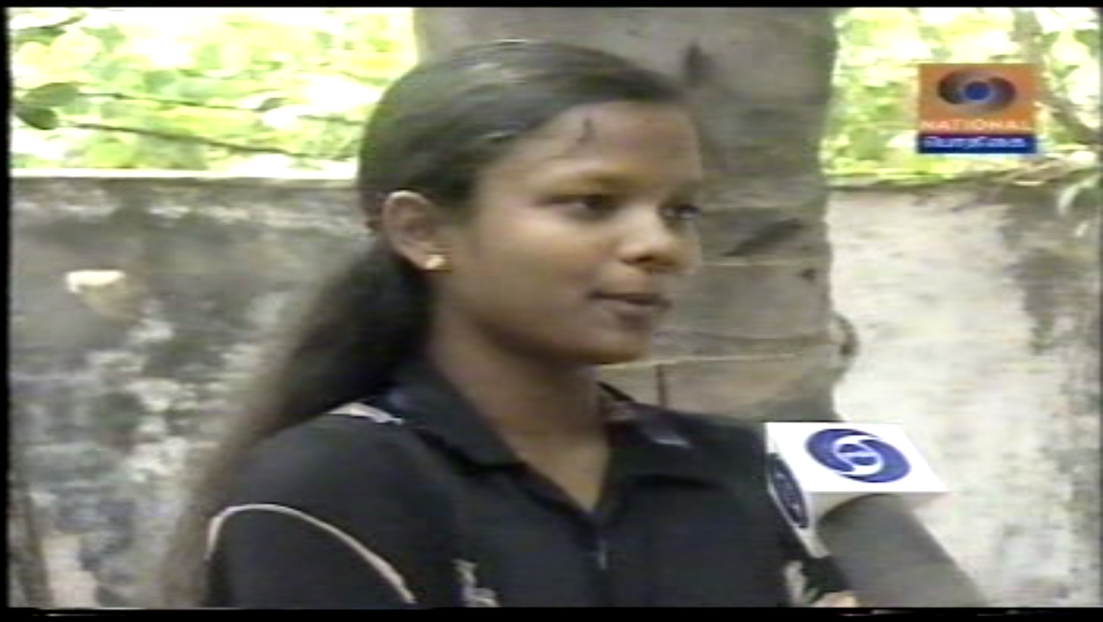
DD PROGRAM COVERAGE (2)

Slide 13
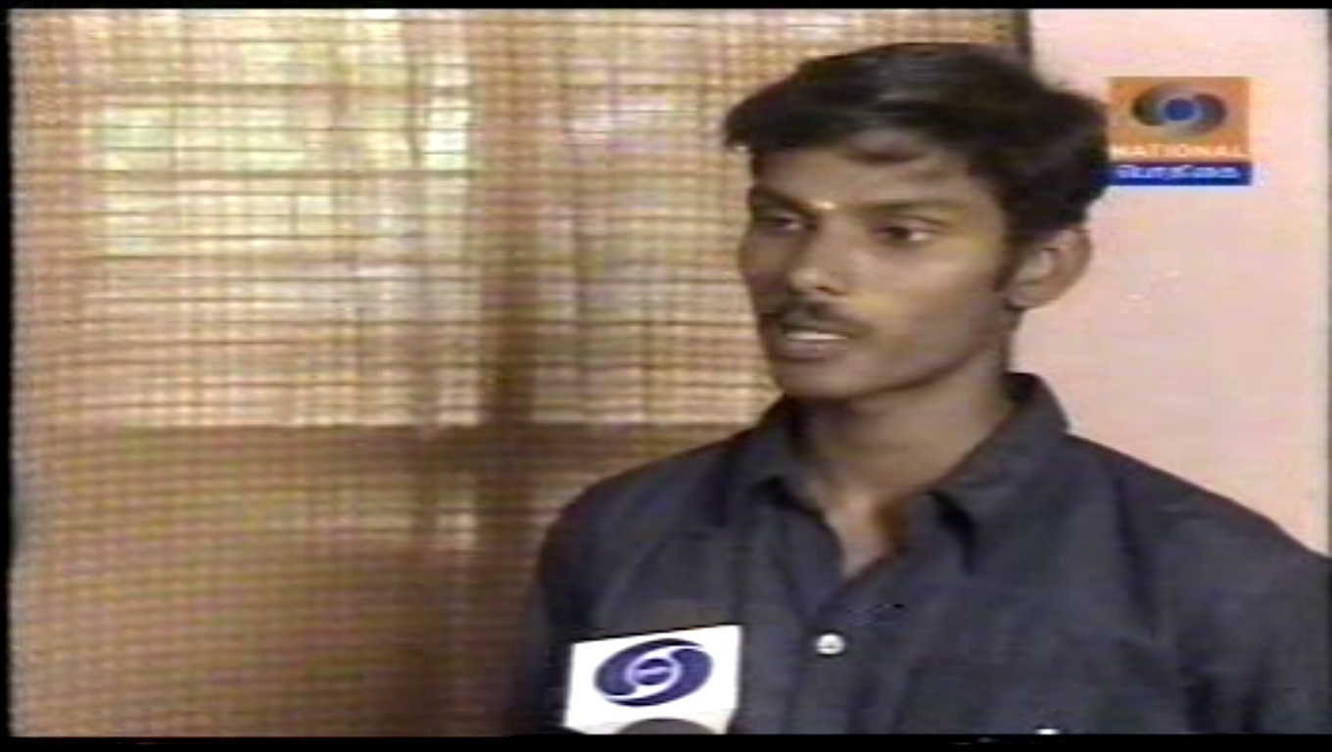
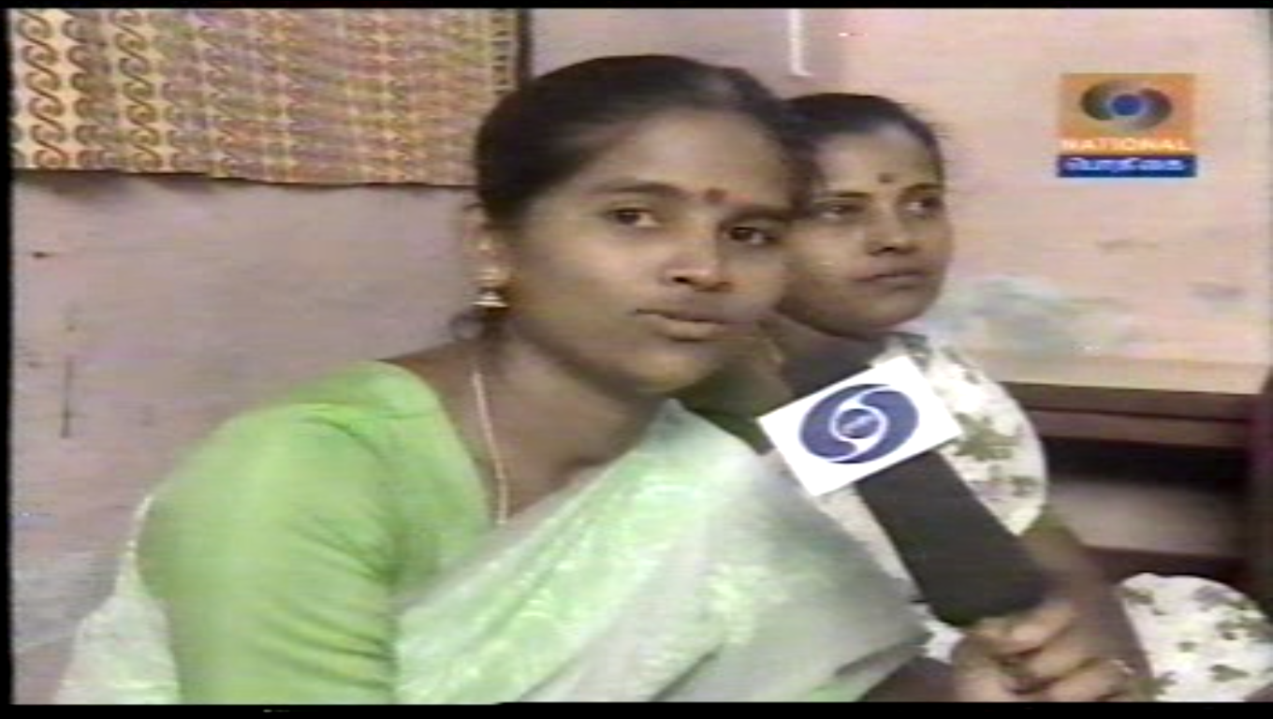
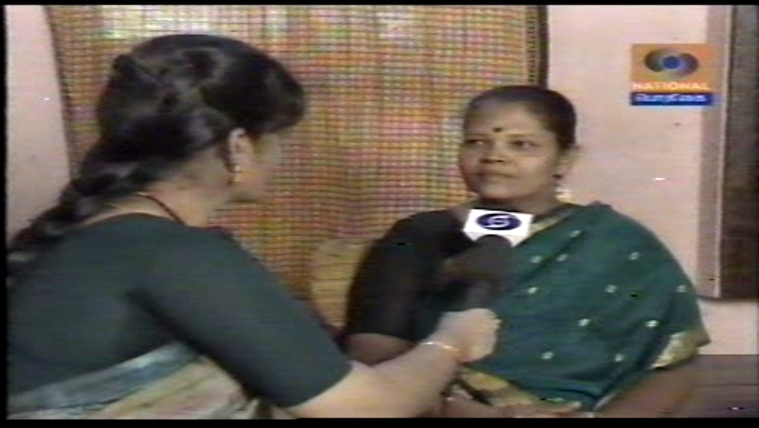
DD PROGRAM COVERAGE (3)

Slide 14
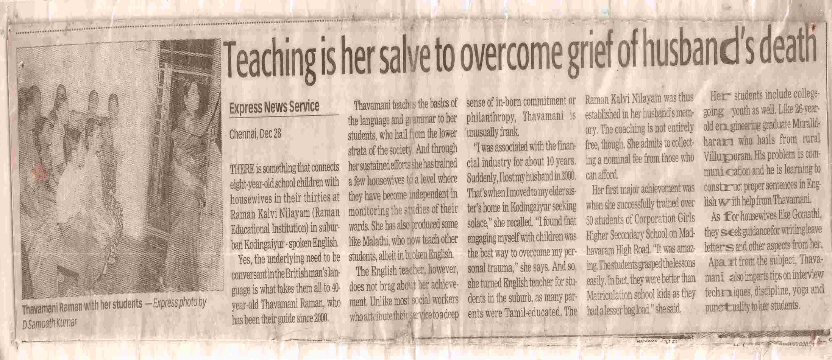
The New Indian Express article

Slide 15
OUR PROGRAMS
We have been offering various courses such as “Communication Skills”, “Personality Development” “Effective Parenting” , “Stress Management and Emotional Intelligence”, “Time Management” , and “Moral Values and Ethics”.

Slide 16
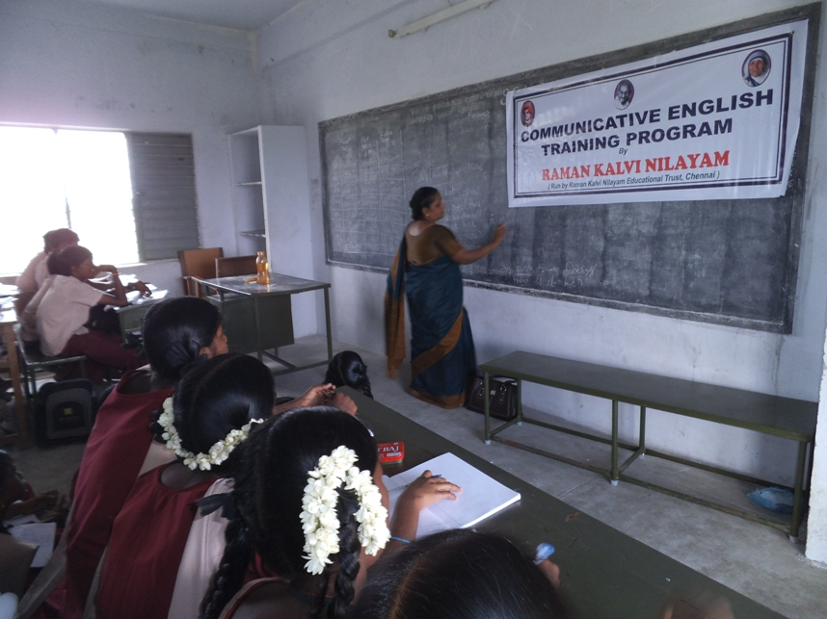
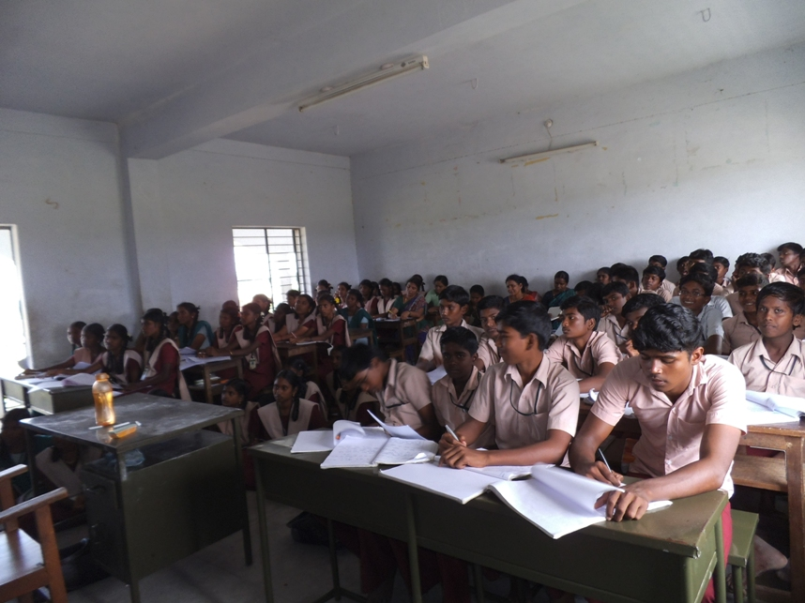
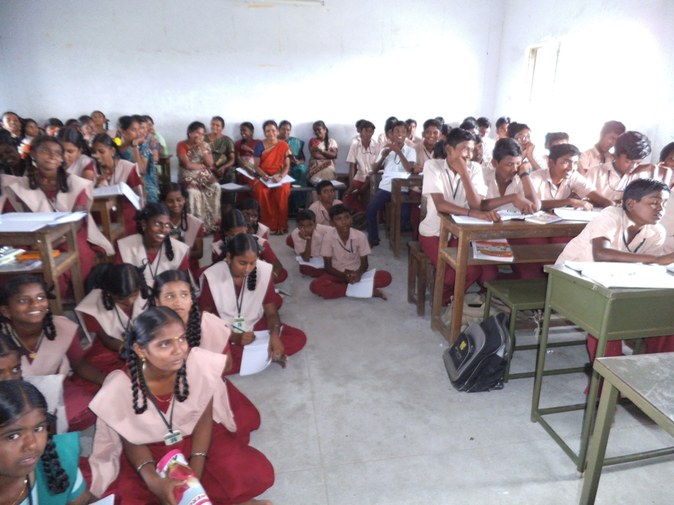
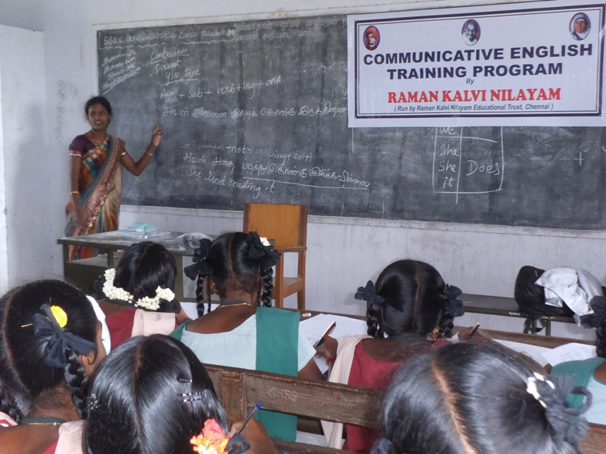
TWO DAY COURSE IN ILAYARASANENDHAL, TIRUNELVELI

Slide 17
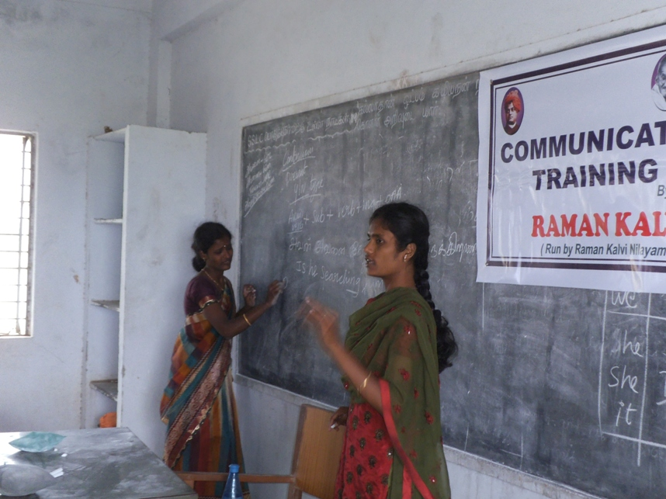
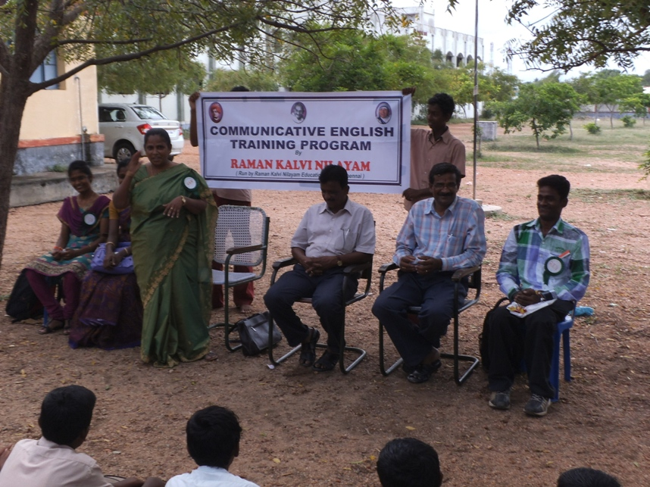
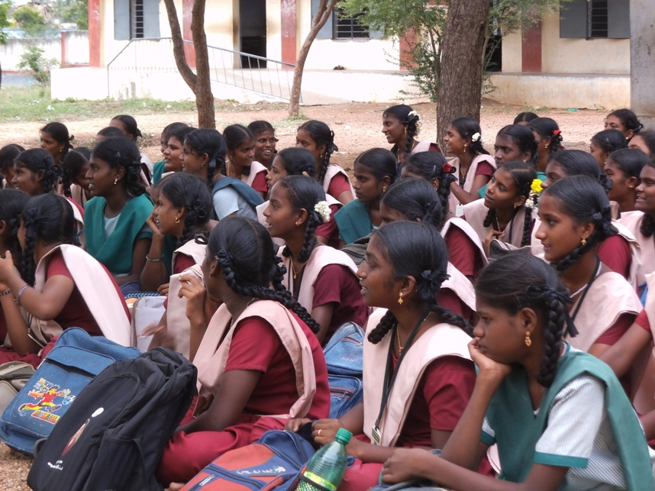
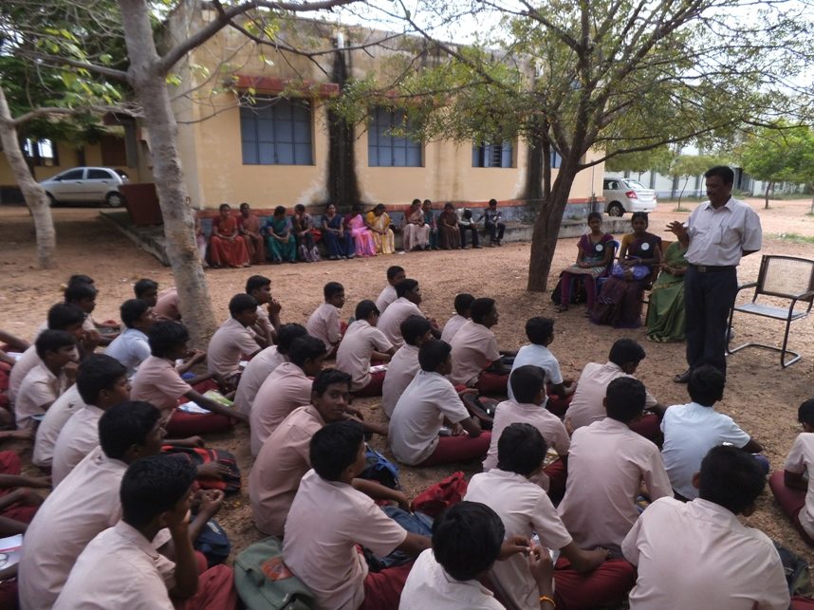
TWO DAY COURSE IN ILAYARASANENDHAL, TIRUNELVELI

Slide 18
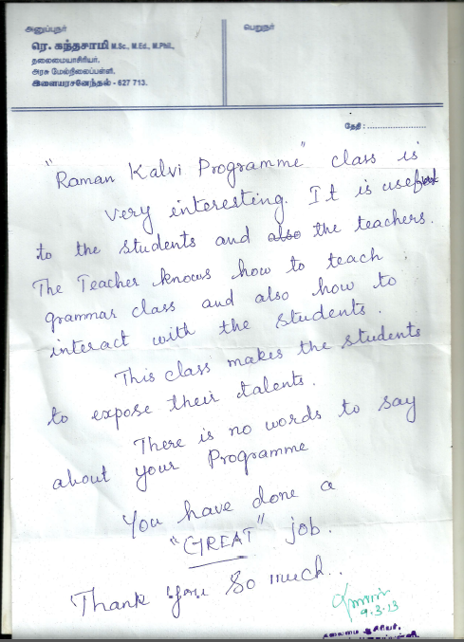
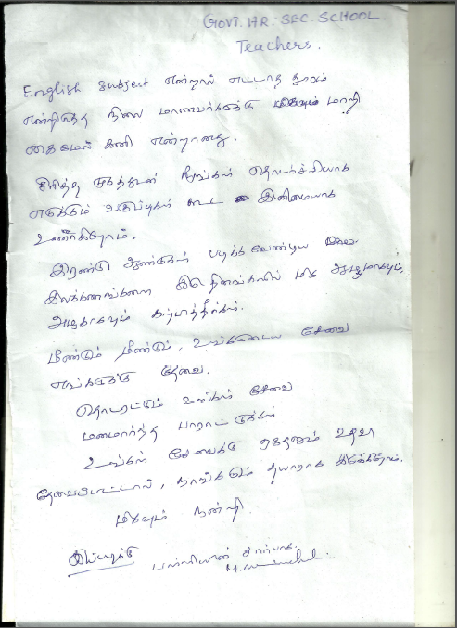
FEEDBACK OF SCHOOL HM AND TEACHERS

Slide 19
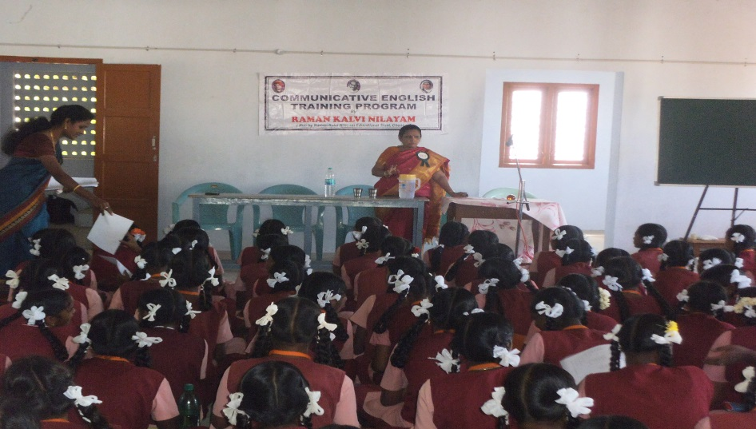
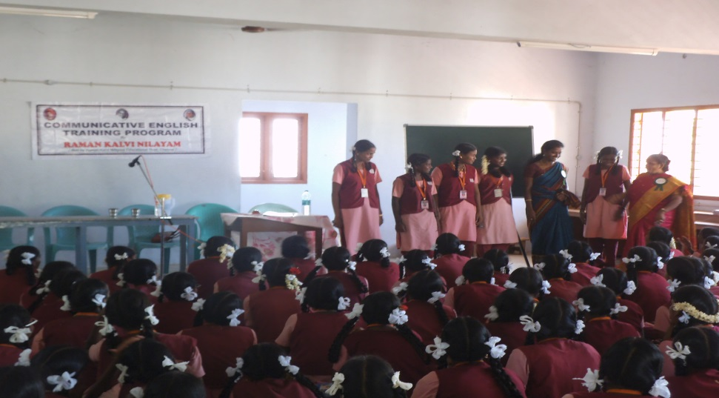
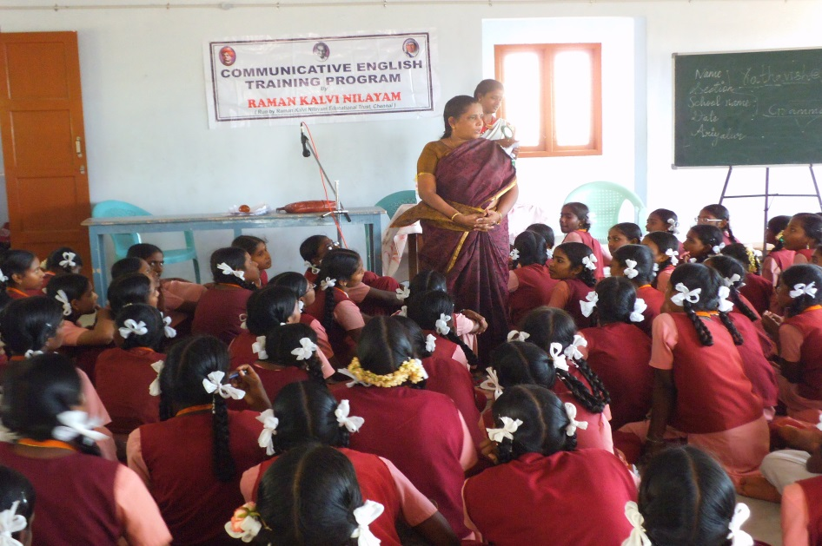
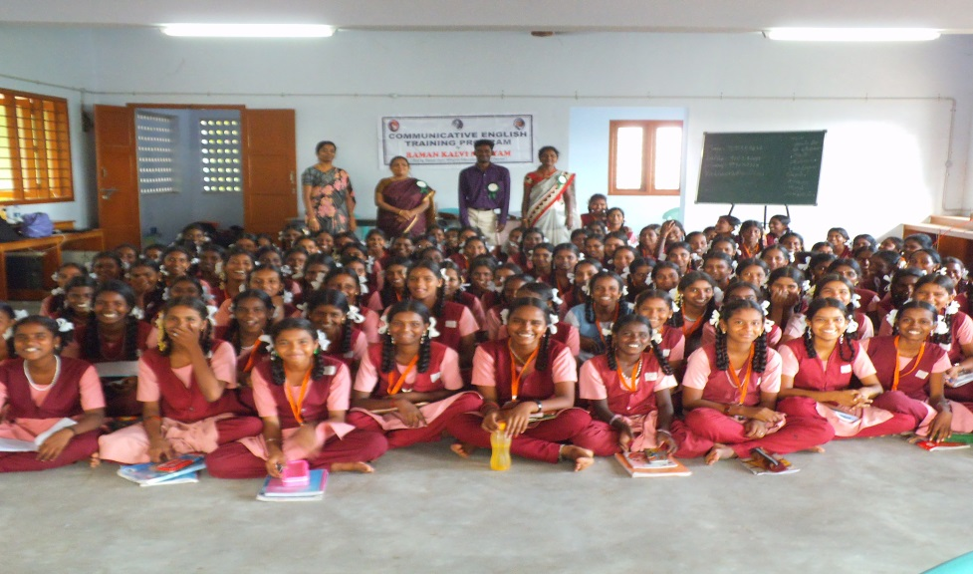
NIRMALA GIRLS HIGHER SR.SCHOOL, ARIYALUR

Slide 20
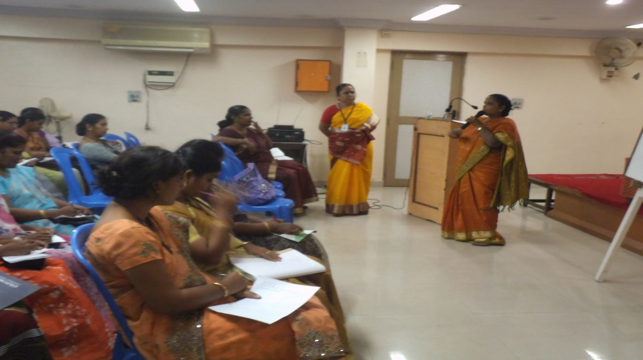
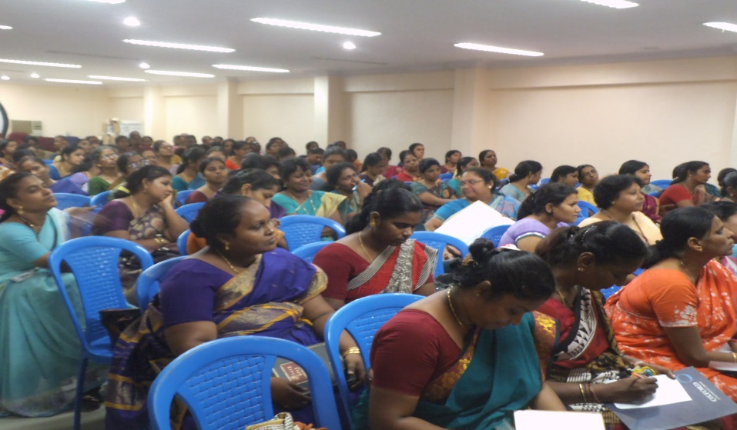
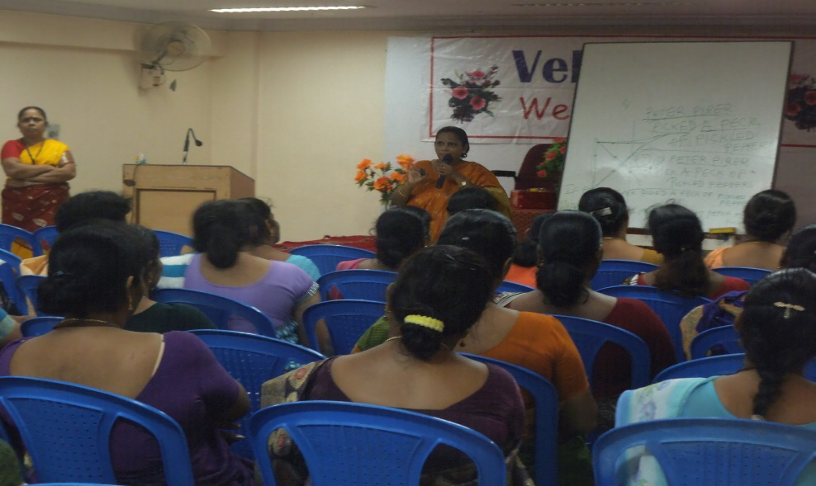
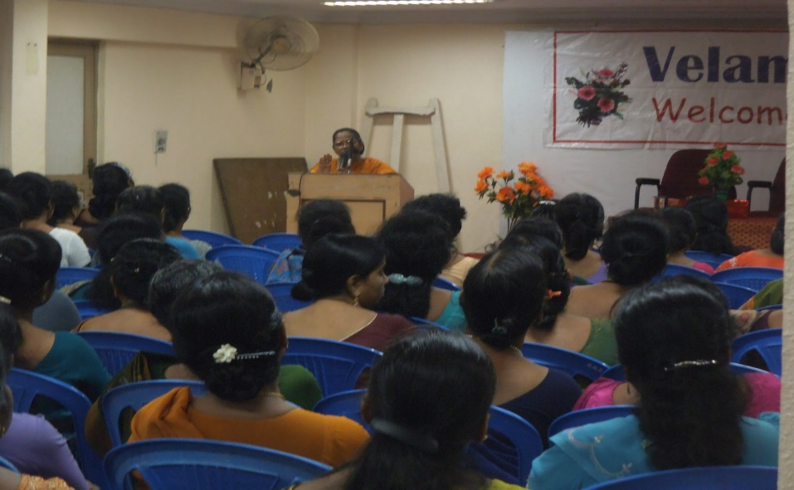
WORKSHOP FOR TEACHERS AT VELAMMAL SCHOOL

Slide 21
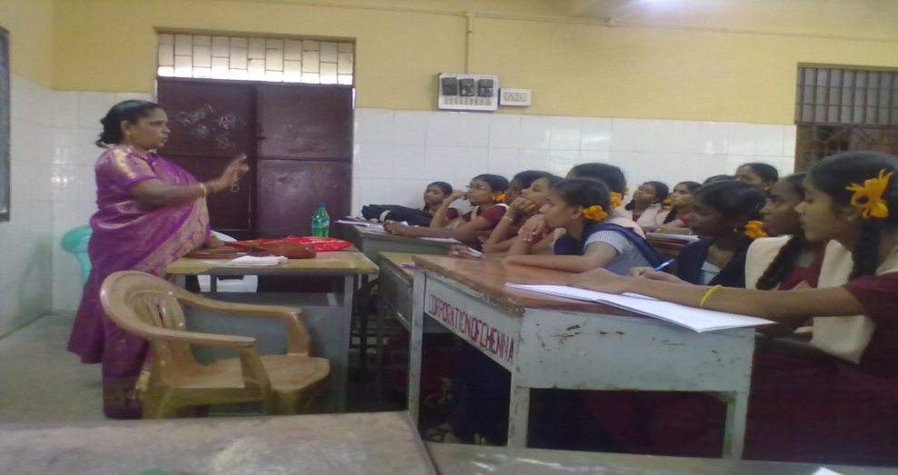
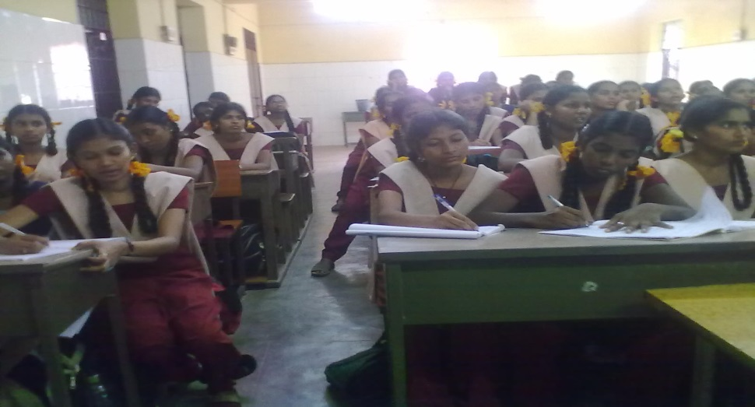
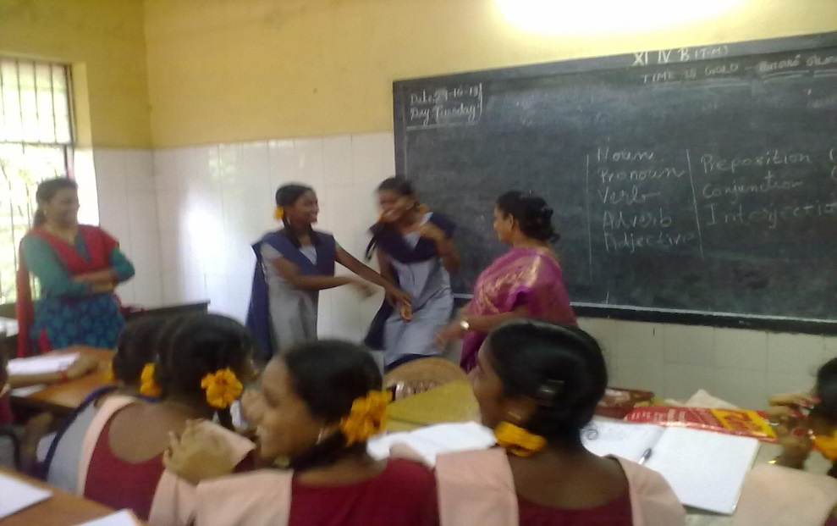
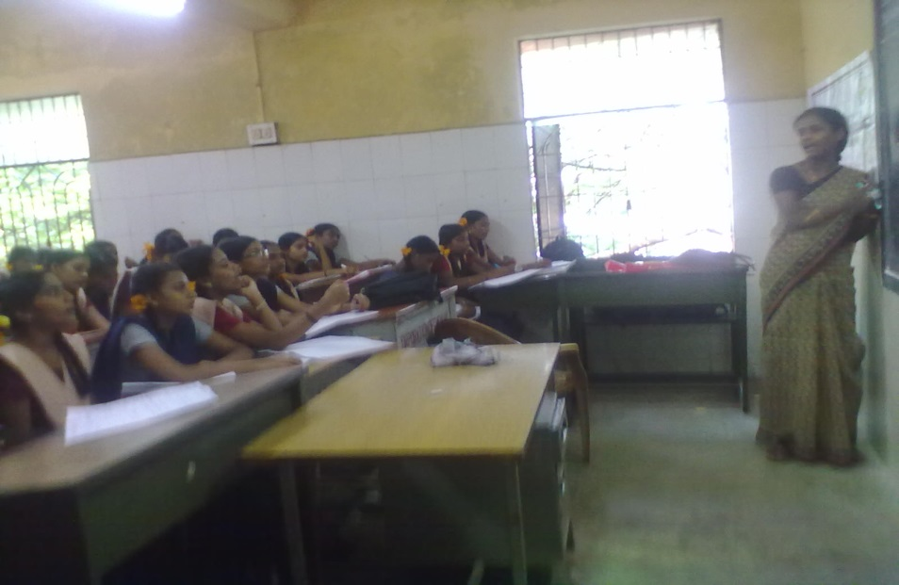
PERAMBUR GOVT. SCHOOL

